Slide 1


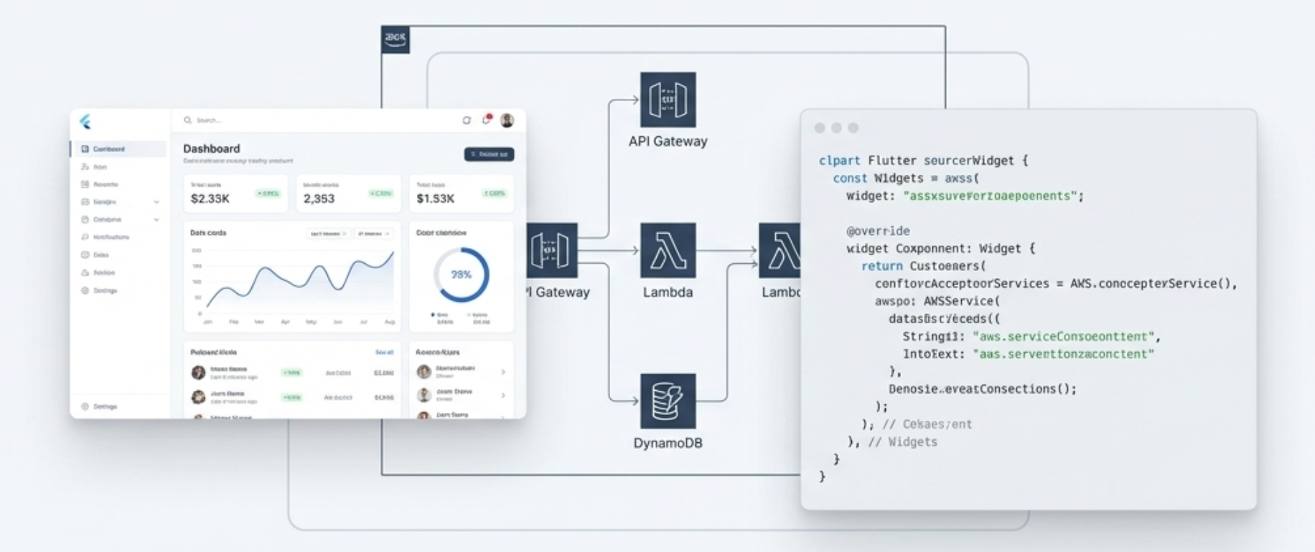
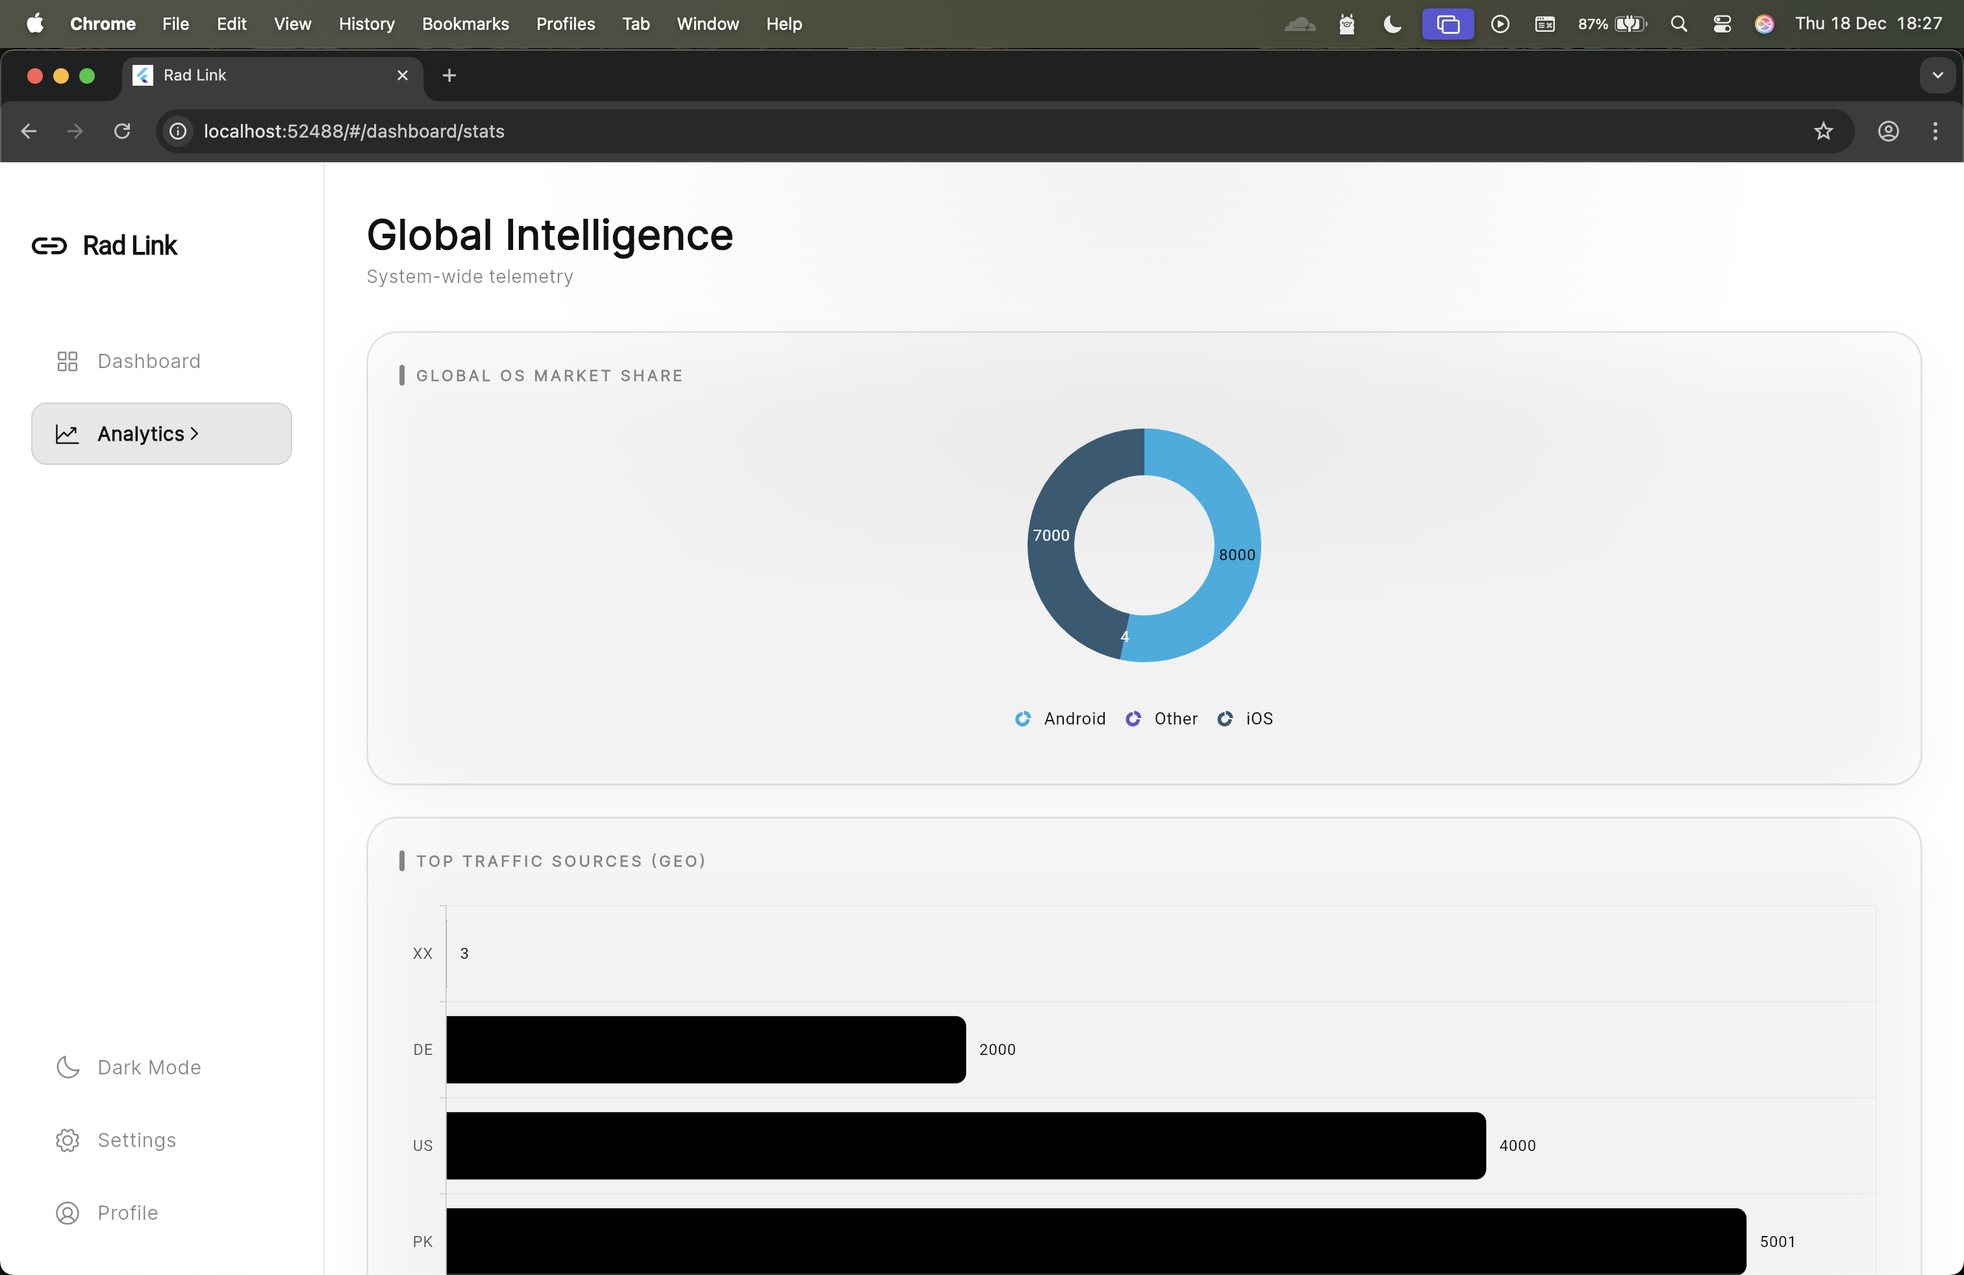
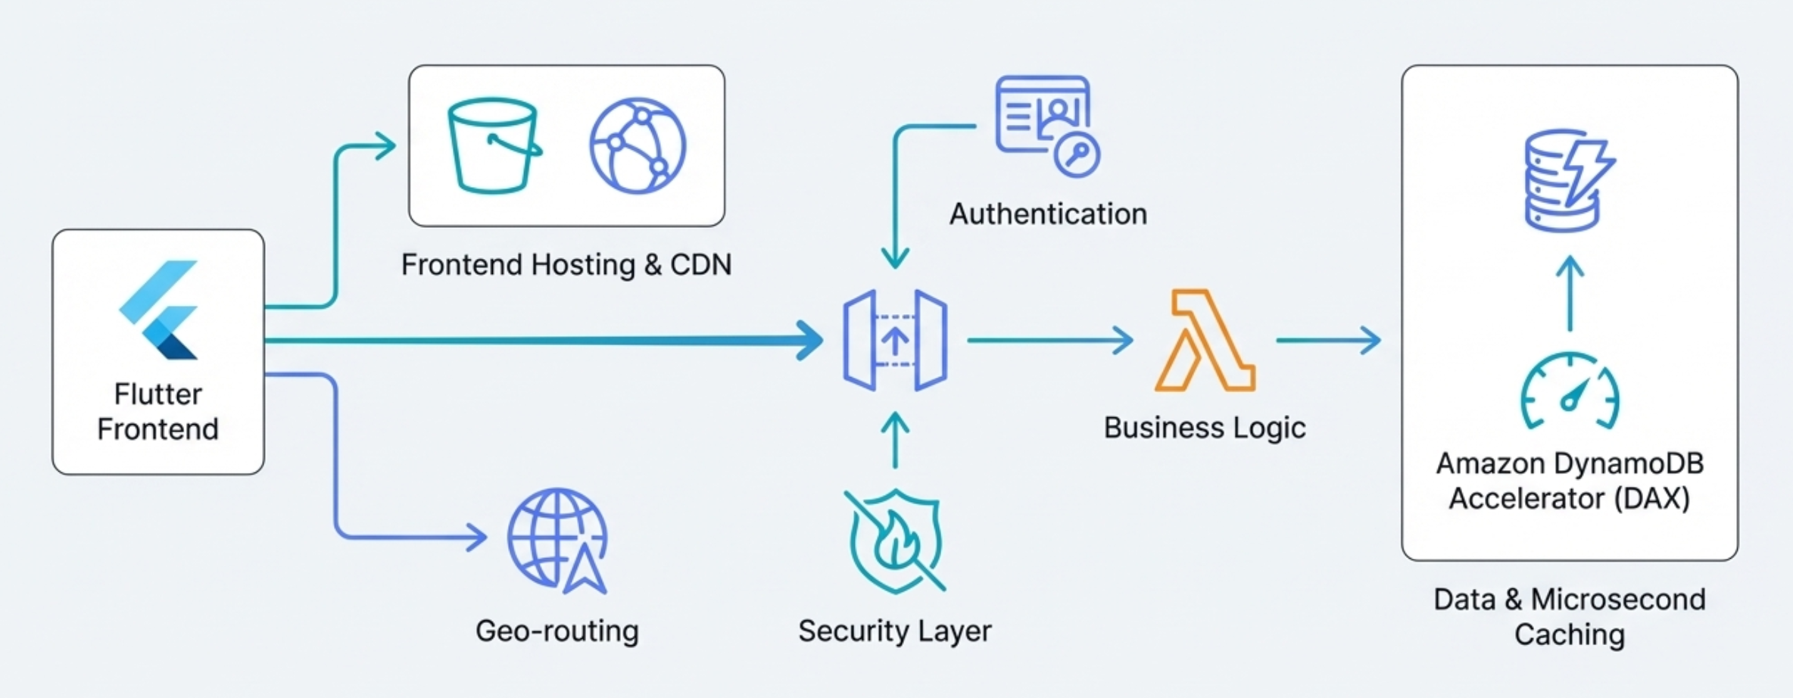


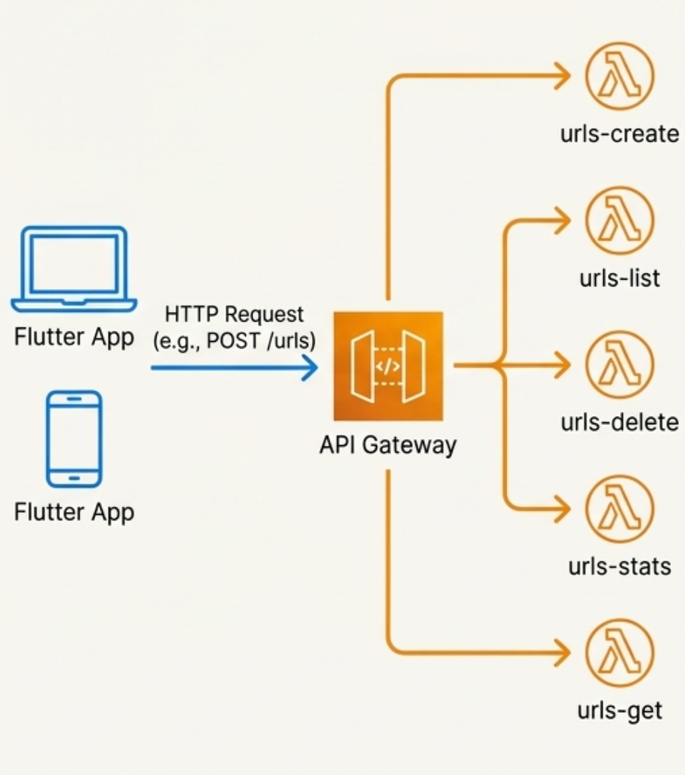
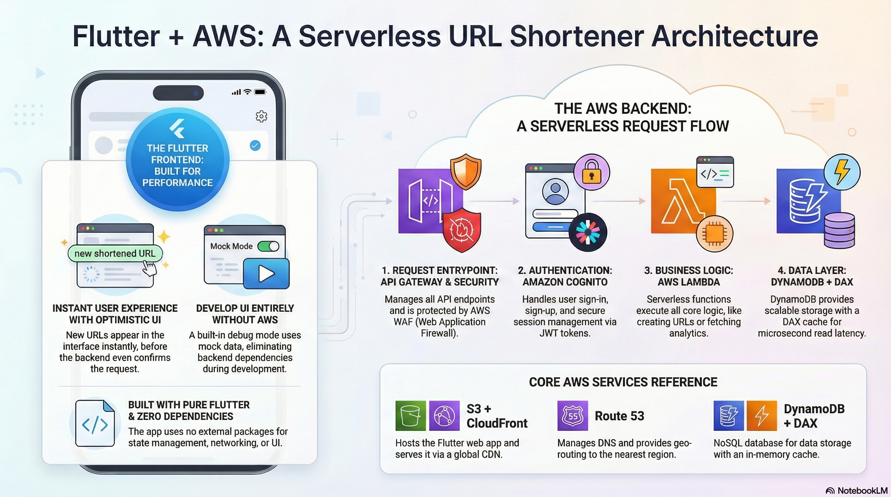
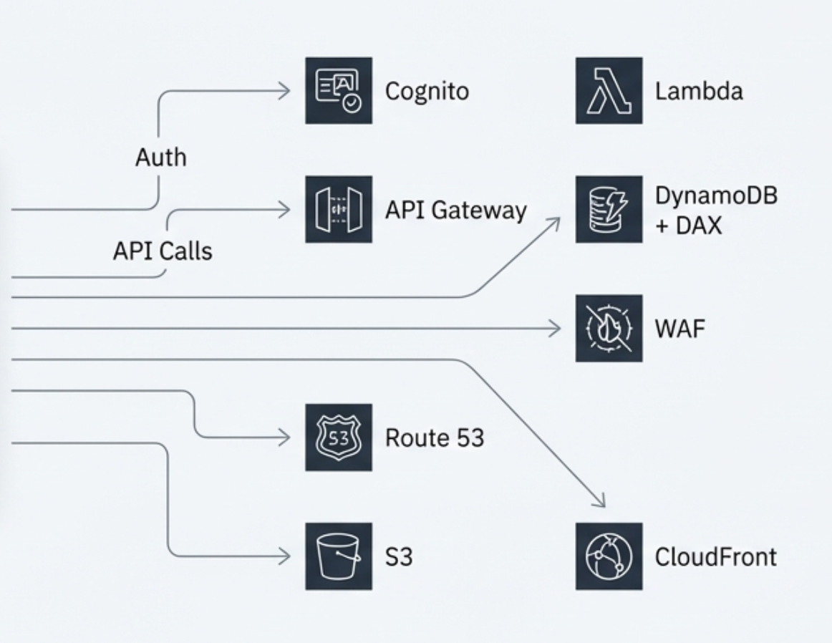
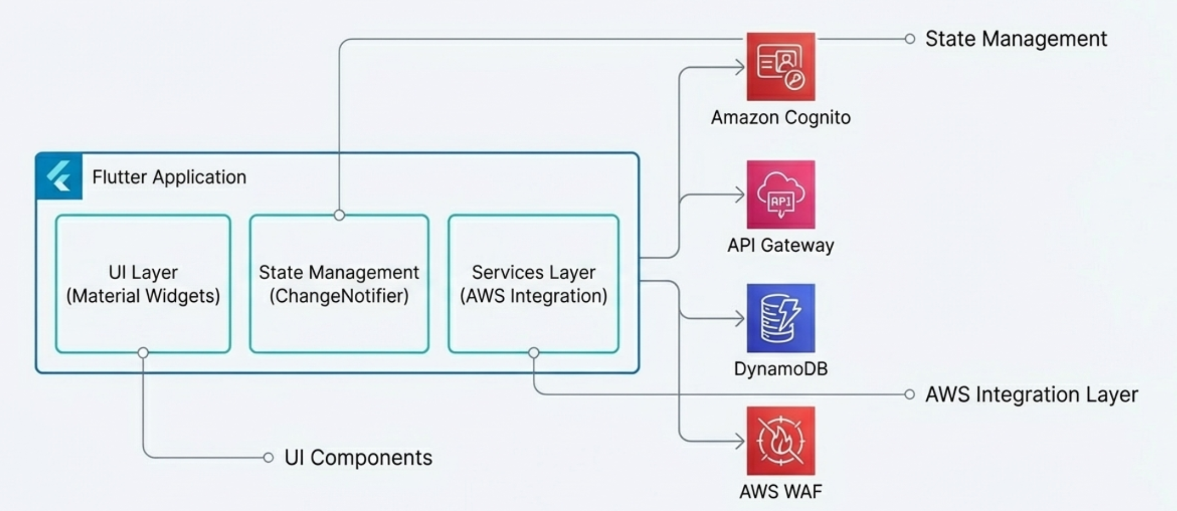

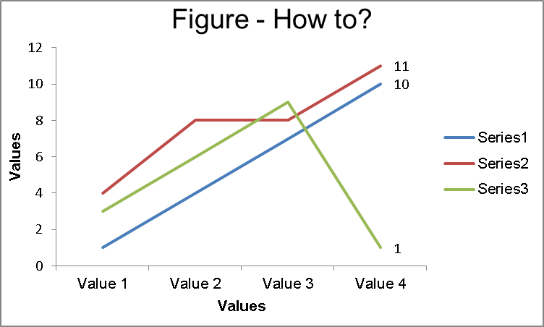
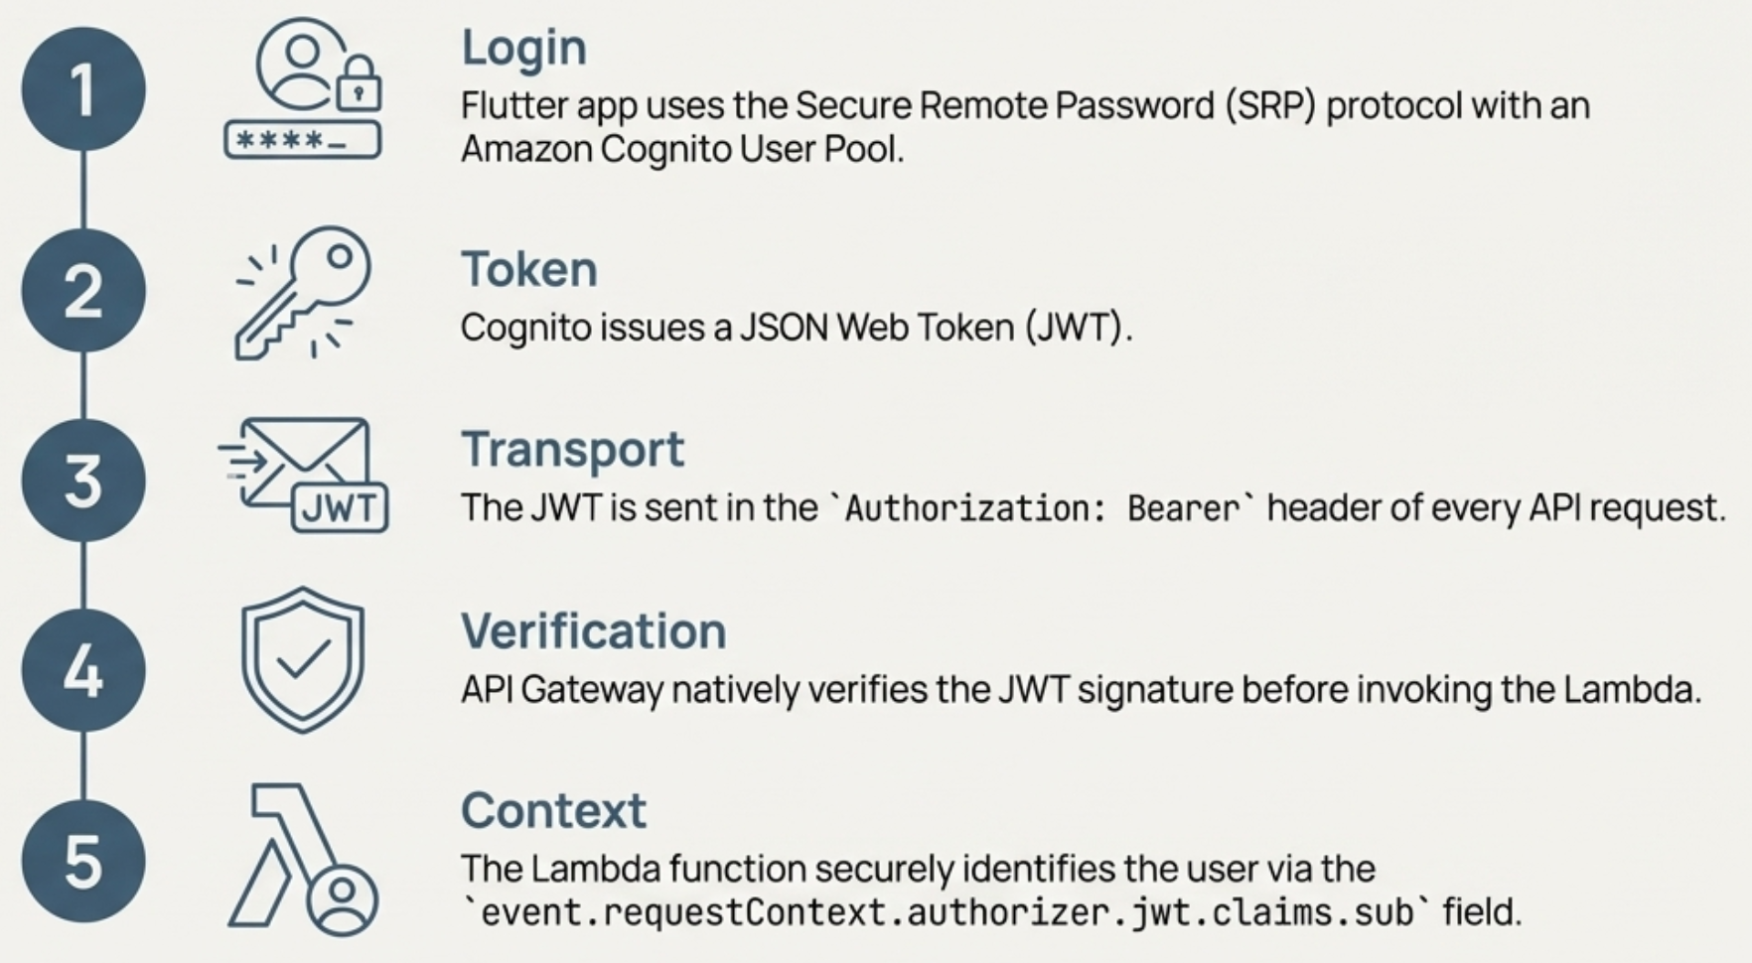
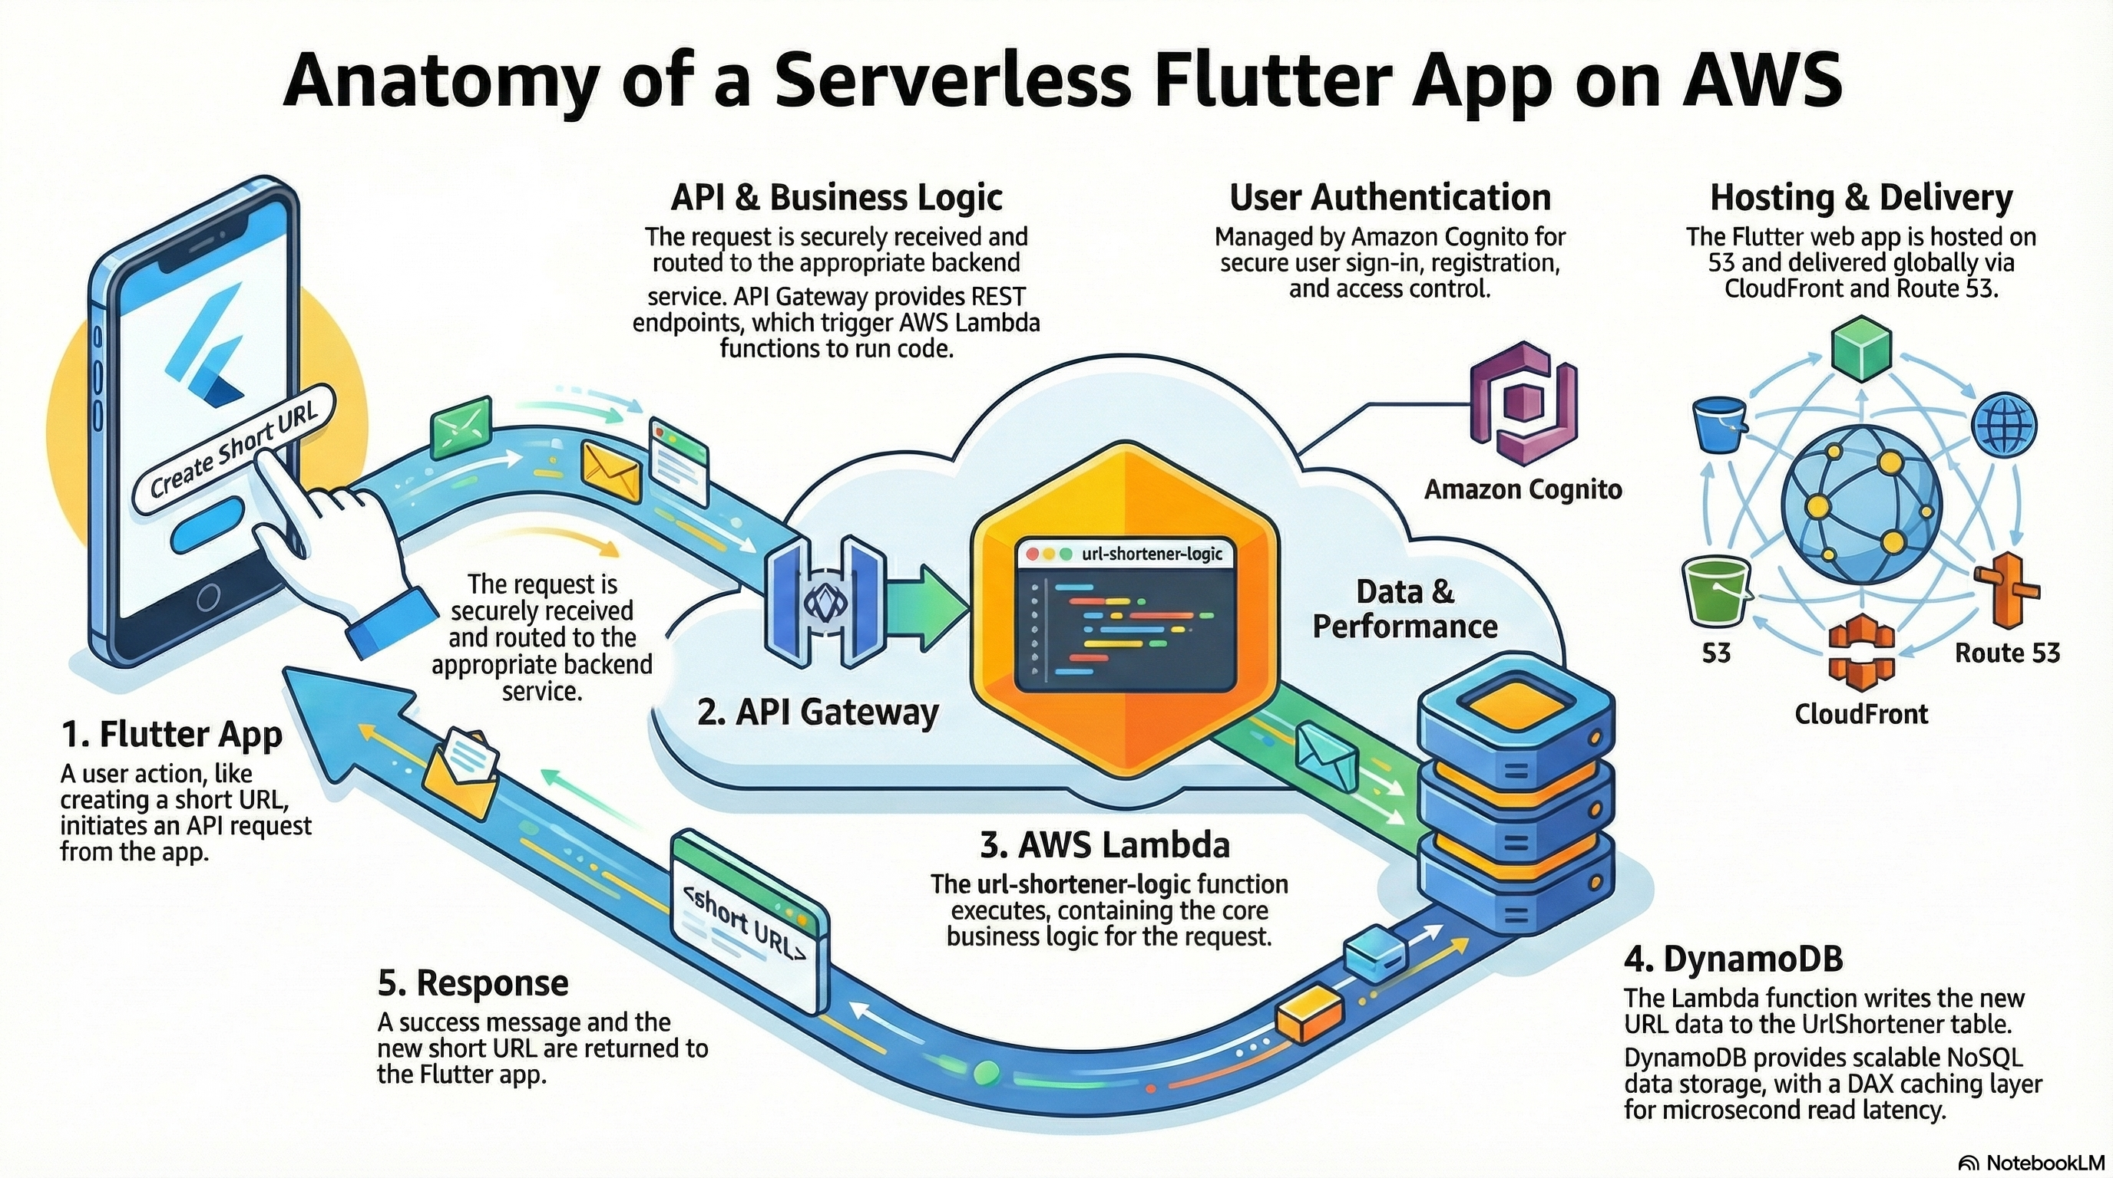
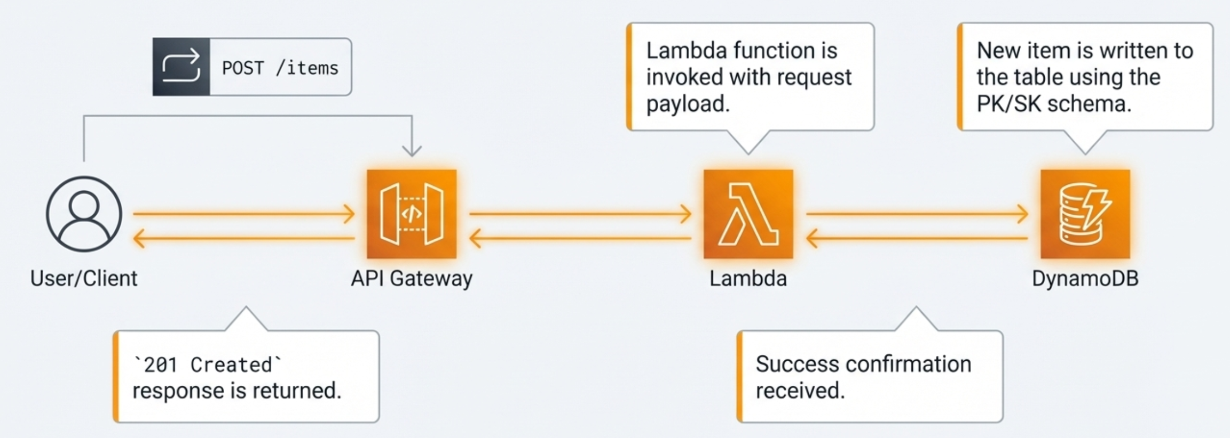
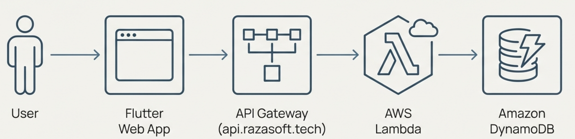
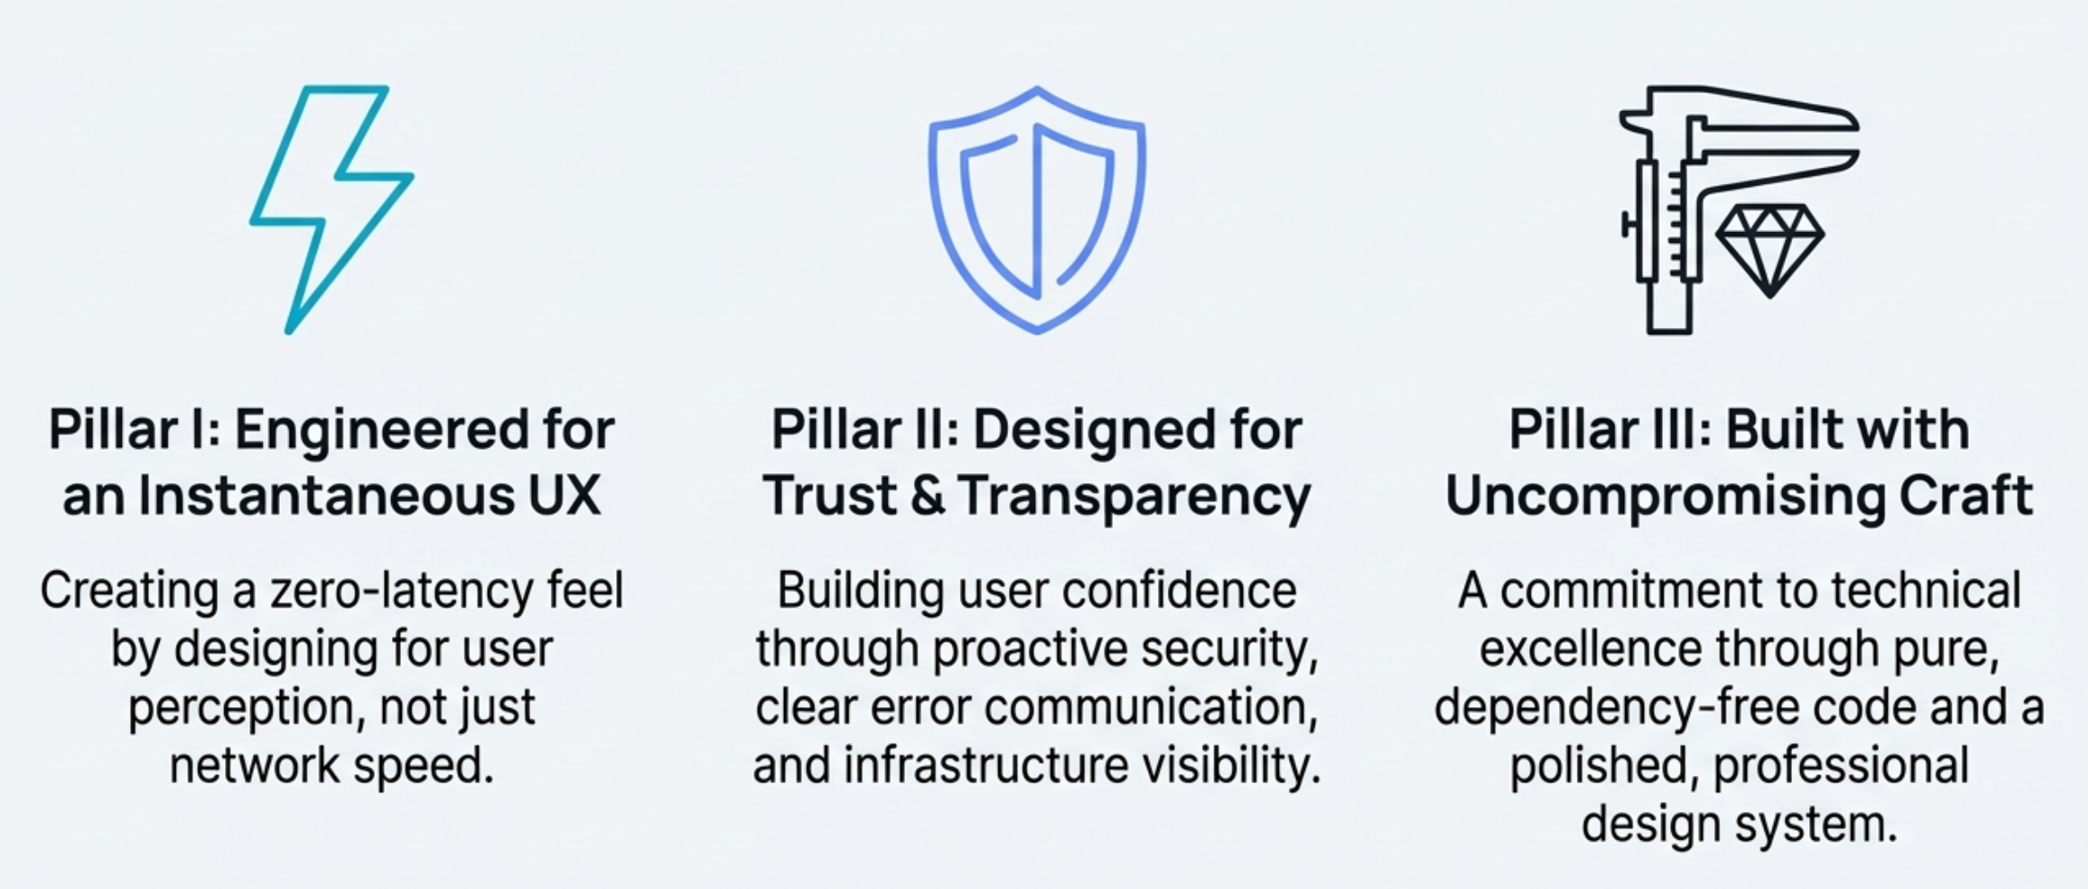
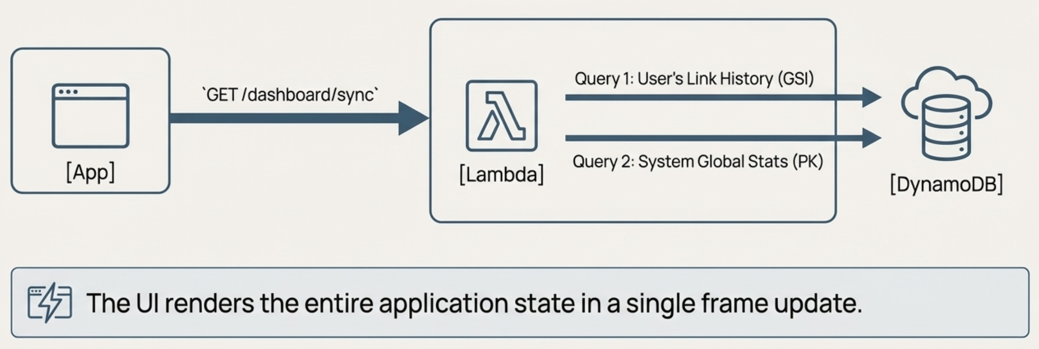
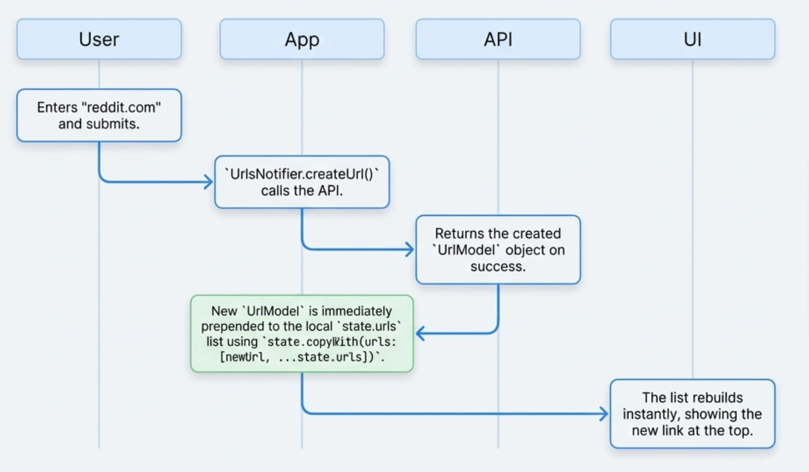
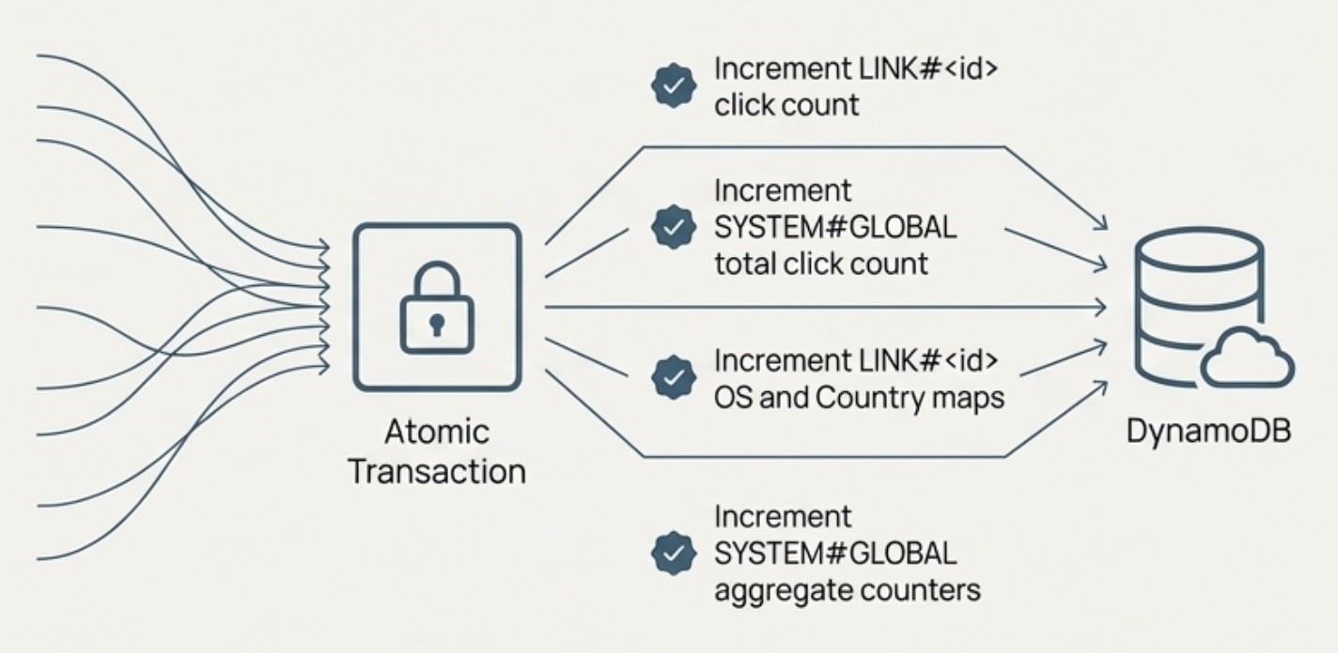
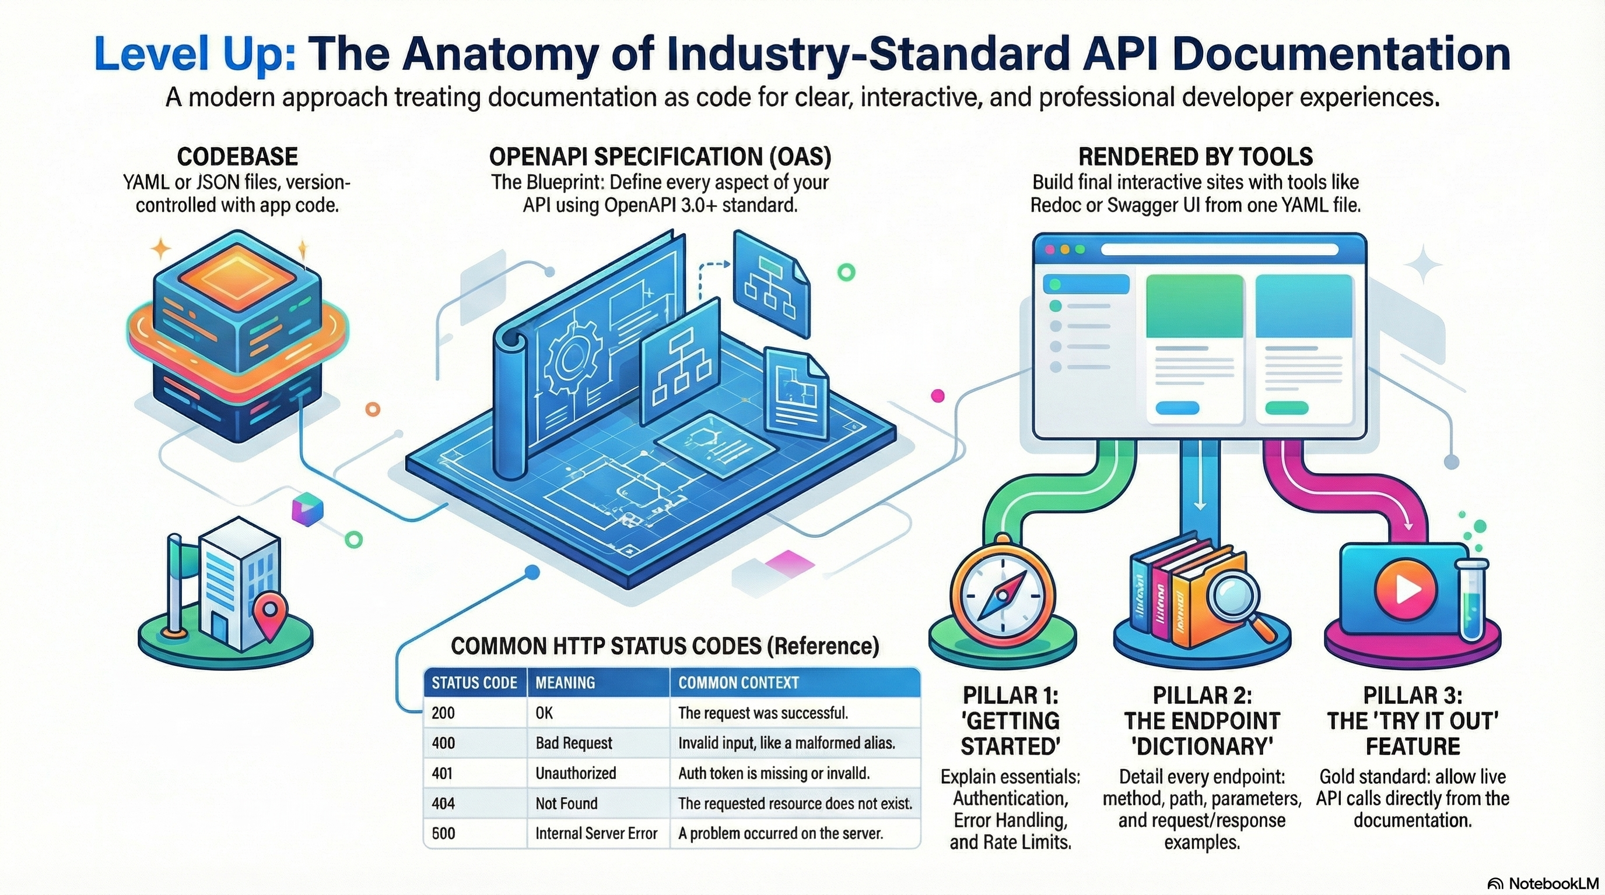
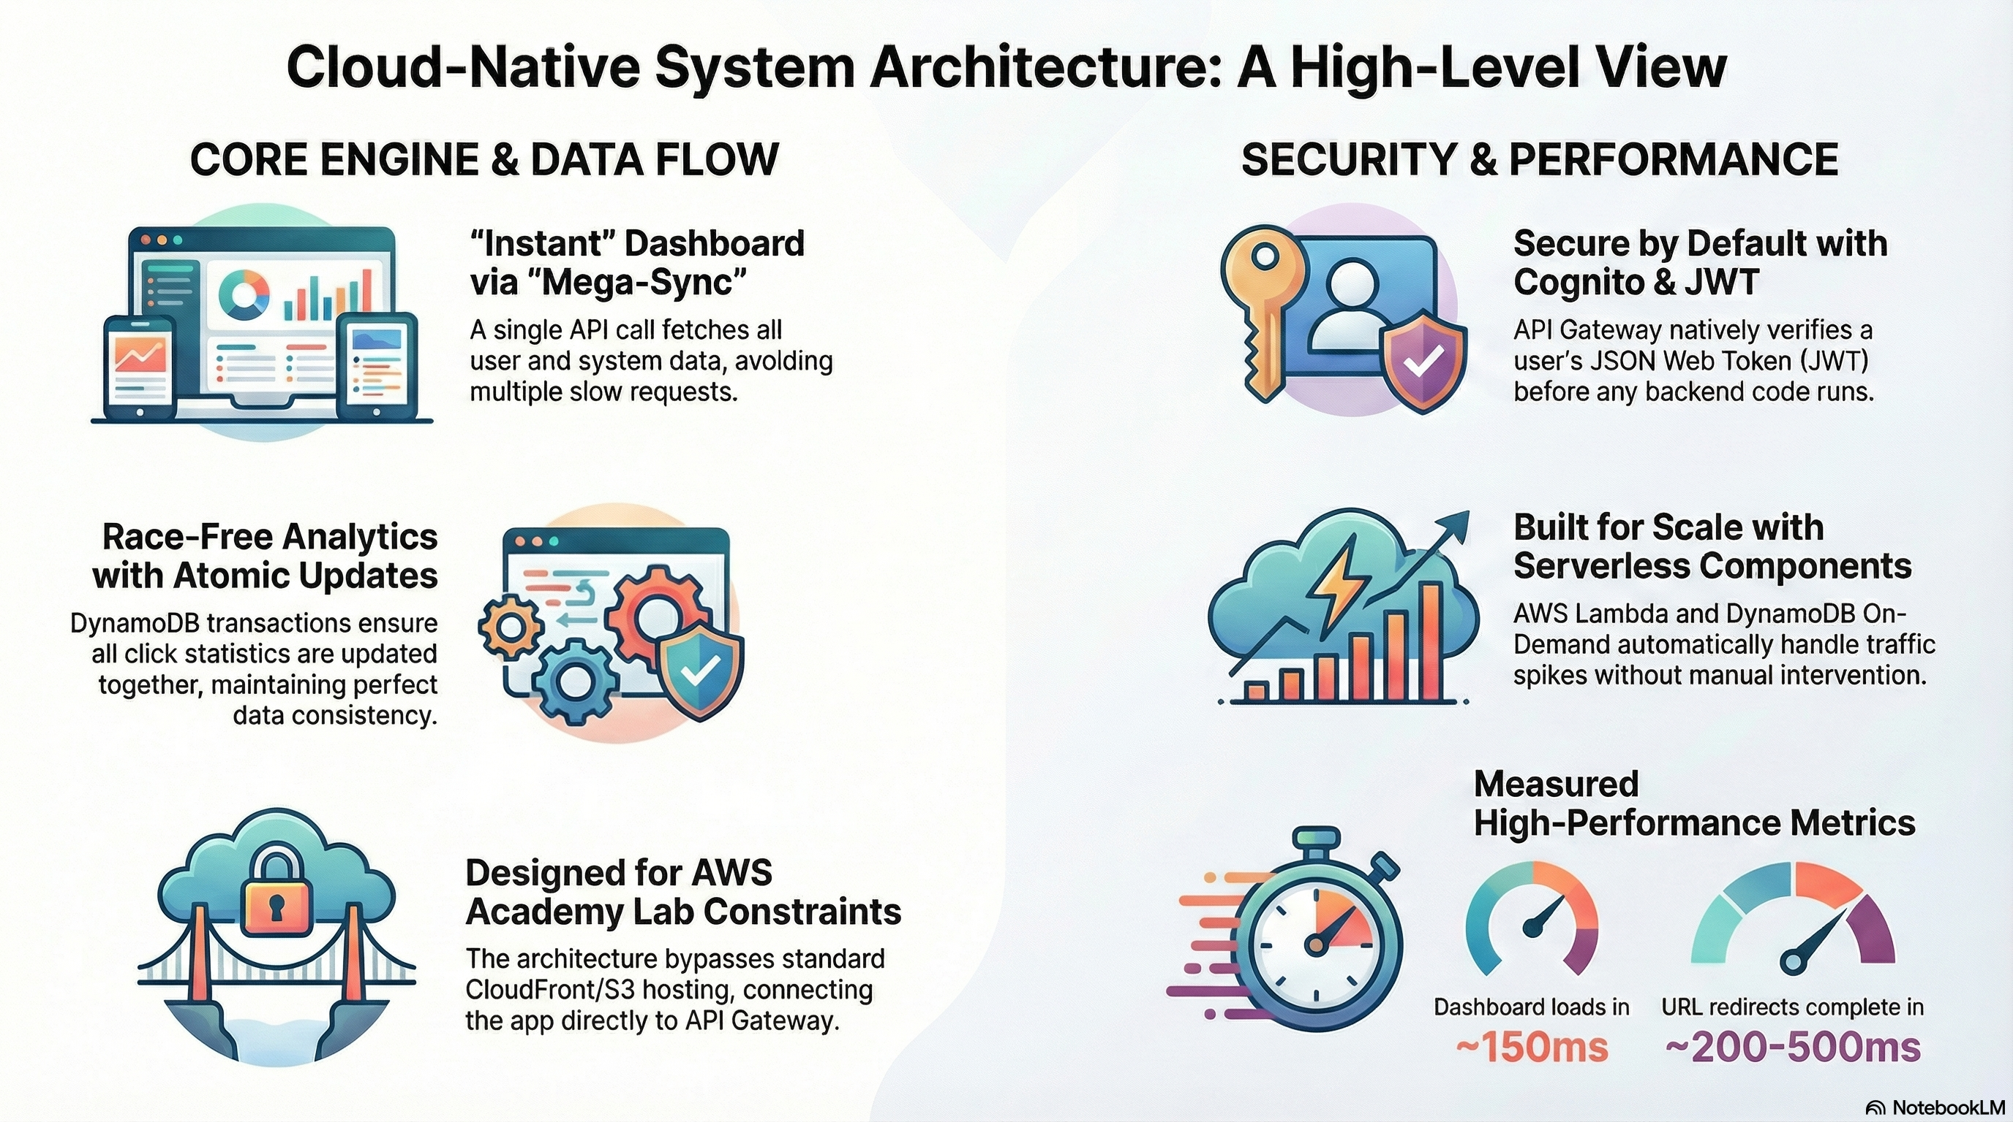
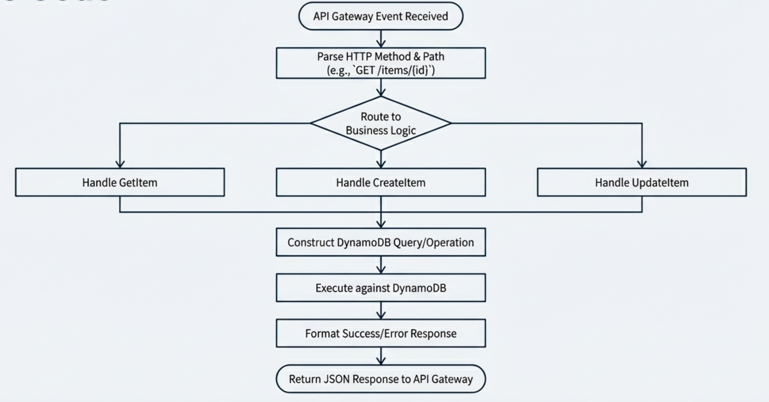
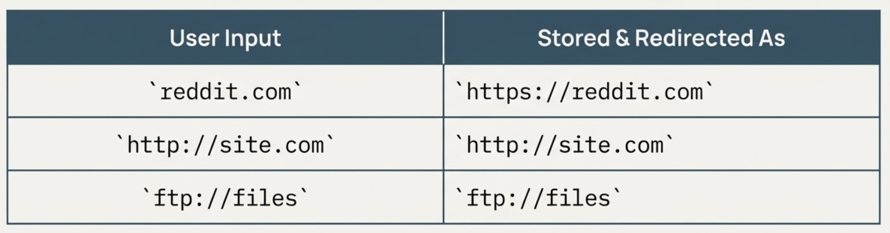
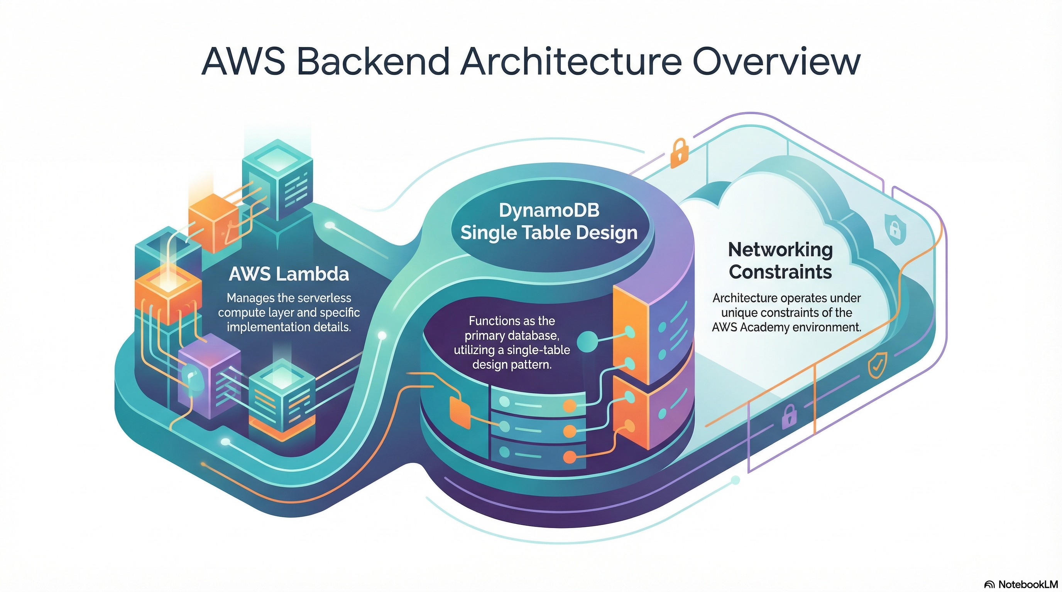
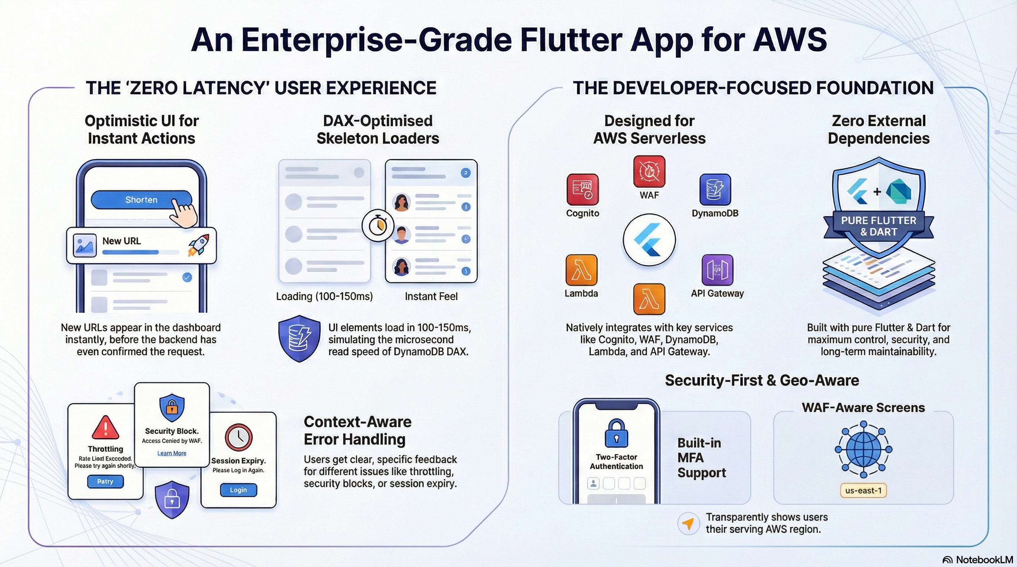
Rad Link: AWS Serverless URL Shortener
Muhammad Mukarram and Muhammad Adil
Dr Zunnurain Hussain | Semester Project | Dec 2025
The Vision: Radical Transparency
Rad Link is not just a URL shortener; it is a high-performance traffic intelligence engine. While competitors hide data behind paywalls, Rad Link is built on the philosophy of Radical Transparency.
Key Innovations:
A unique, system-wide visualization engine that aggregates global metrics in real-time.
Live tracking of Android vs. iOS usage across the entire platform.
Geo-spatial data aggregation to identify high-density traffic zones instantly.
A poster paper presentation is a graphic display of a written manuscript. The poster is a summary of research and usually contains an overview of research objectives, experimental methods, materials, results, discussion and conclusion.
Please use the formatting embedded in this template.
Please print your poster A1 size.
A poster paper presentation is a graphic display of a written manuscript. The poster presentation stands by itself as a summary of research and usually contains an overview of research objectives, experimental methods, materials, results and a discussion.
Please use the formatting embedded in this template.
Please print your poster A1 size.
LIVE ECOSYSTEM
Frontend UI
The successful deployment of premium digital real estate. We didn’t just build an app; we launched a brand.
The Production Domain:
razasoft.tech
A fully optimized Flutter Web Application delivered via custom DNS.
The Backbone API:
api.razasoft.tech
This endpoint represents a triumph over AWS Academy constraints. By
routing traffic through a custom EC2 SSL termination layer, we achieved a
secure, verified HTTPS handshake for our custom API domain something typically impossible in student environments.
The frontend is builtwith Flutter3.x. It implements an Optimistic UI pattern to eliminate perceived network latency.
The “Cyber-Glass” Experience:
Instant Feedback: When a user interacts with the domain, the UI updates instantly while the API synchronizes in the background.
Mega-Sync Engine: A single call to the API hydrates the entire dashboard state in one frame.
Table 1 – How to build a table for a poster
Title
Value 1 | 1 | 2 | 3
Value 2 | 4 | 5 | 6
Value 3 | 7 | 8 | 9
Value 4 | 10 | 11 | 12
This table only shows key figures & is easily understood. The side box gives a brief description of what is in the table
Enter your discussion text here.
Enter your discussion text here
Enter your discussion text here
Enter your discussion text here
This figure shows trends & is easily understood.
The side box gives a brief description of what is in the figure.
Unified Compute Architecture
We utilize a Monolithic Lambda (Node.js 20.x) to handle all
traffic hitting api.razasoft.tech.
DynamoDB Single Table Design: We maximized efficiency
by overloading keys in a single table.
Atomic Transactions: Using TransactWriteItems, a single
click triggers three atomic updates simultaneously: the link count,
the user’s stats, and the global dashboard.
Figure 1 – How to build a graph for a poster
Business Value & Scalability
The ability to secure and deploy custom domains transforms this from a coding project into a marketable SaaS product.
Key Deliverables:
Full control over DNS allows for professional branding via razasoft.tech.
DynamoDB On-Demand capacity handles viral traffic spikes hitting the domain without manual sharding.
By decoupling SSL from managed services, we reduced infrastructure overhead significantly.

